Slide 1
openSUSE in 13 kittens
Conference/event name
Location
name
openSUSE Ambassador
name@opensuse.org

Slide 2
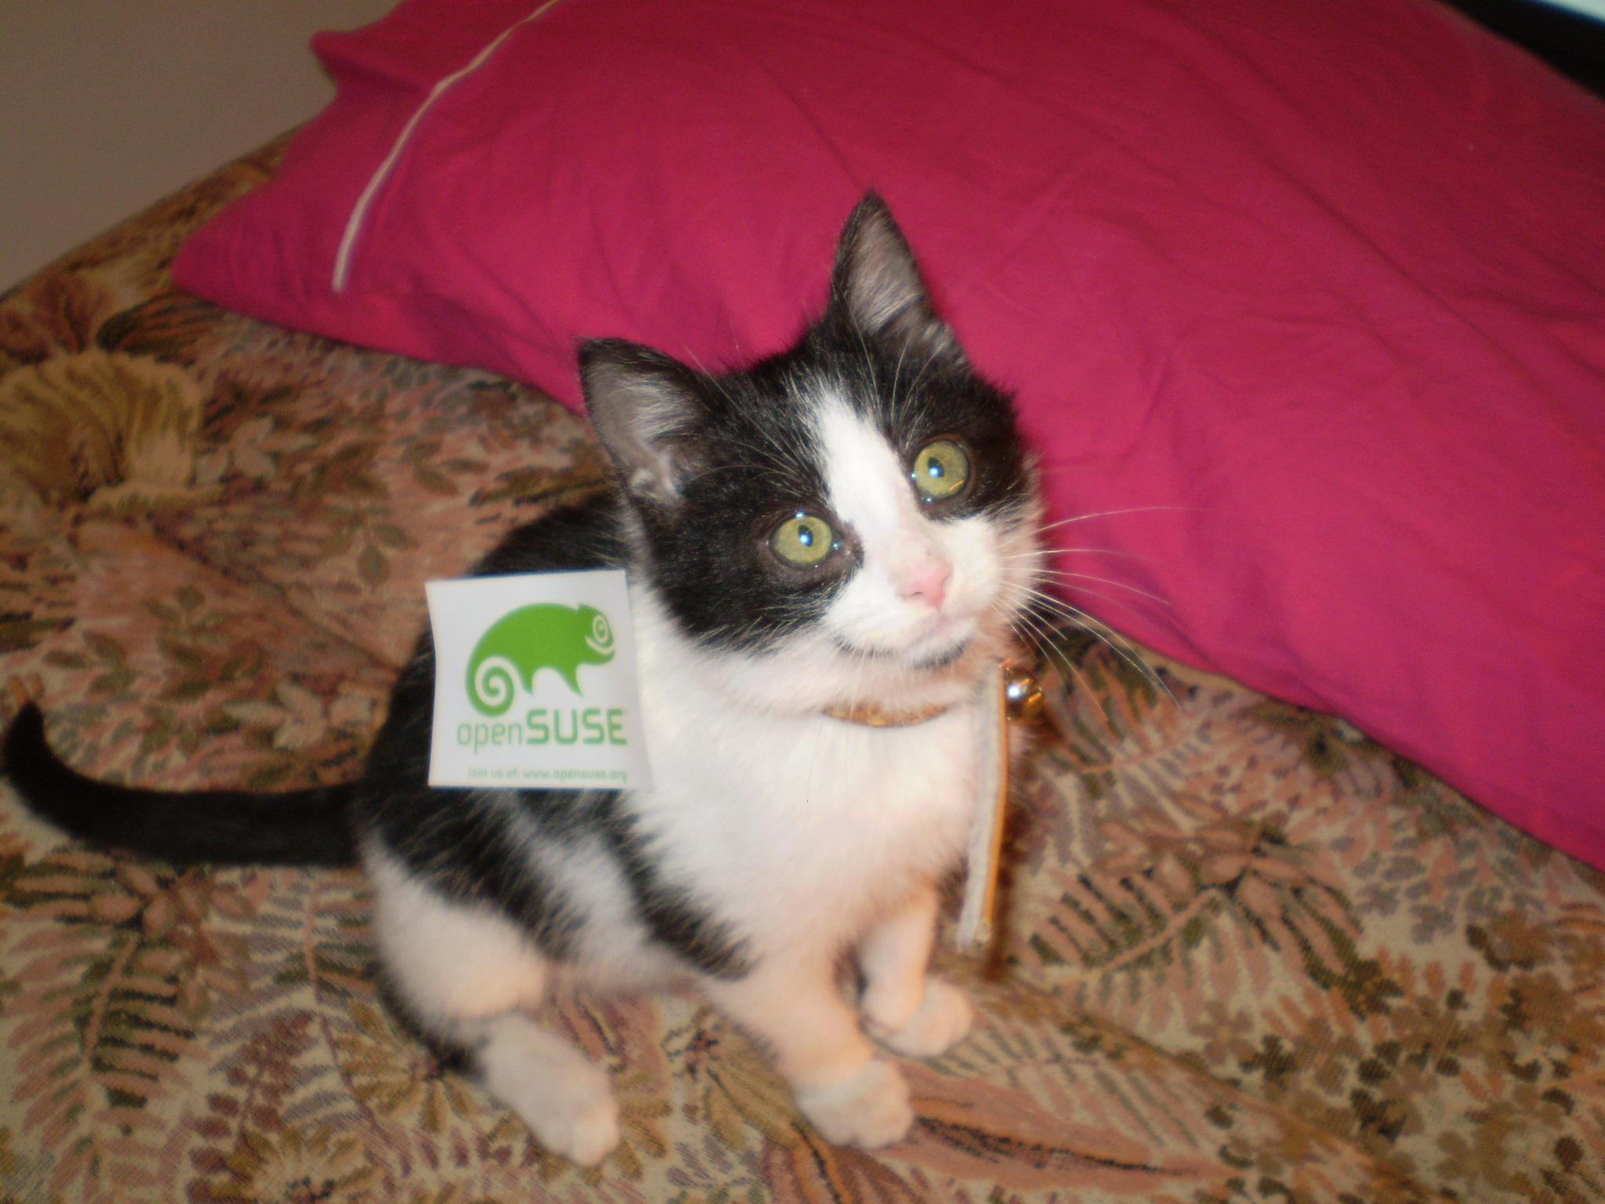
Me
Notes:
I am of course an openSUSE kitten. My name is (etc talk about yourself)

Slide 3
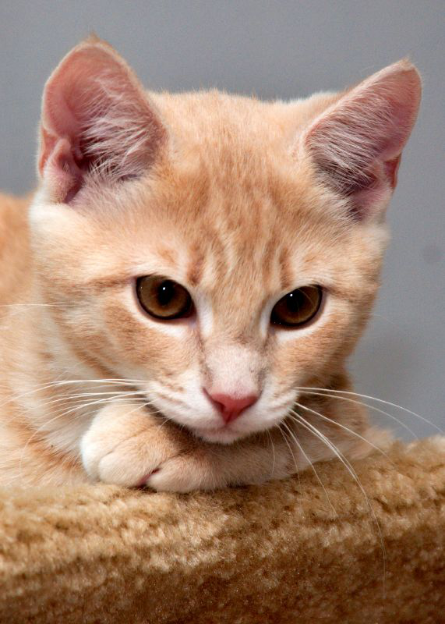
You
Notes:
Subjects of my talk:
A bit of openSUSE history, who we are and where we're going.

Slide 4
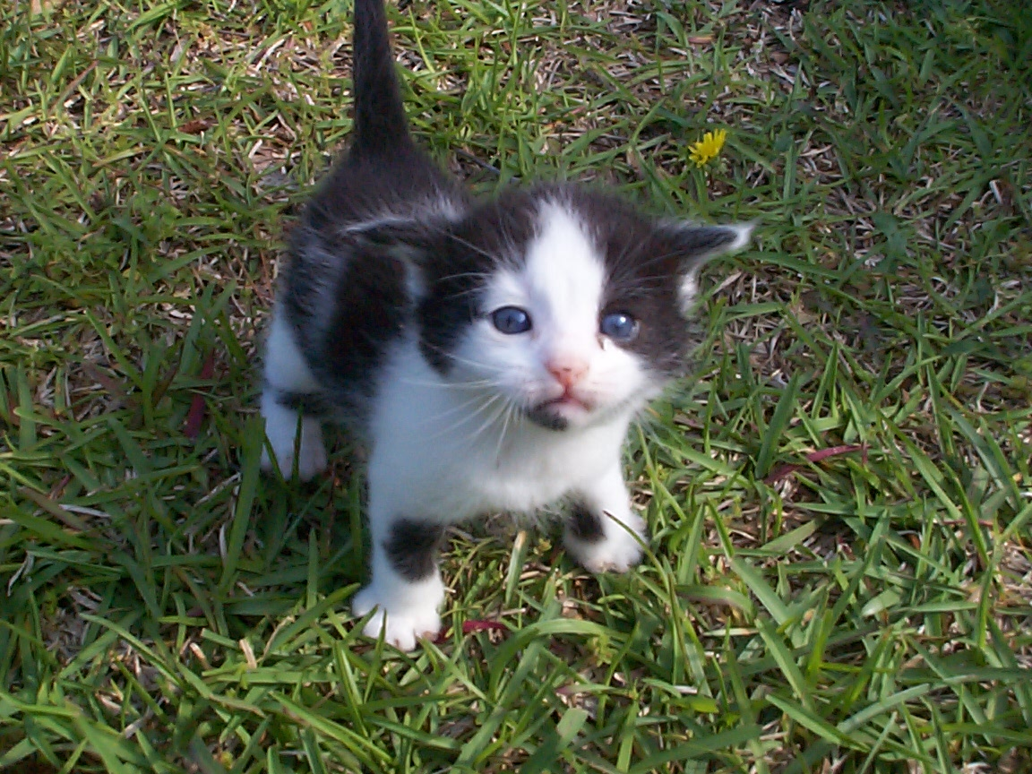
openSUSE
Notes:
openSUSE young?
SuSE GmbH 1994 - oldest commercial linux distro.
Initially German translation of Slackware! Later the SuSE developers ported RPM to Slackware and started to add more and more features and finally went their own way, trying to make Slackware easier to use. SuSE grew quickly and was bought by Novell in 2004.

Slide 5
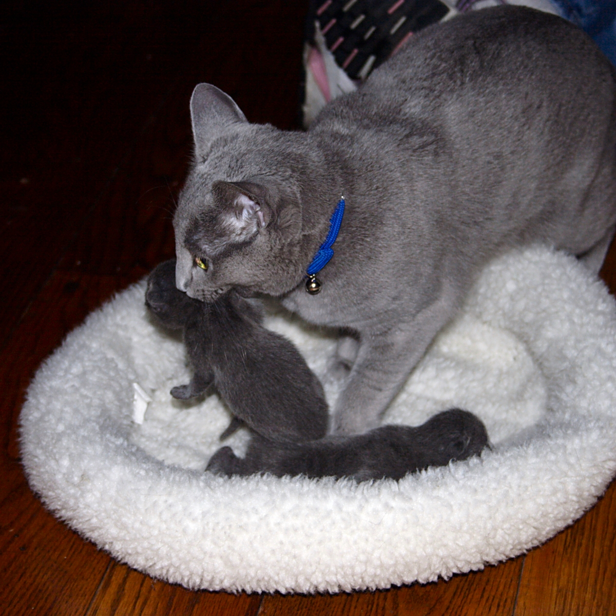
SUSE
Notes:
Novell decided that the consumer version of SUSE was not very interesting so it became free. Later on it was decided to open up development - community development ensured openSUSE was what users wanted. Also, Novell hoped the community could help it innovate and do new things.
But it took time to open up openSUSE development, only in second half of 2009 became Factory (our development repository) open for non-Novell employees! So in a way you could say openSUSE was really born then...
Now, after the take-over of Attachmate, we're SUSE.
For SUSE, the goal with openSUSE is simple: make openSUSE successful.
If openSUSE is successful, SUSE has a good base to build upon with their commercial products SLES and SLED.

Slide 6
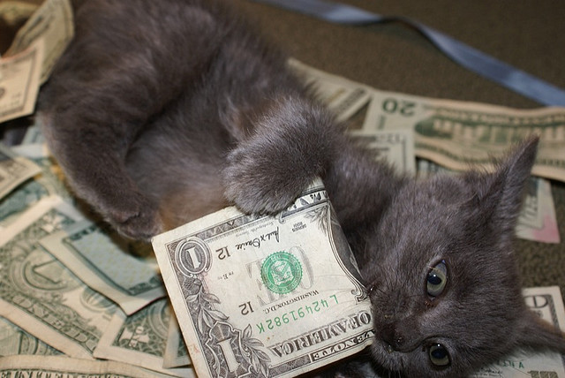
Business
Notes:
Business model SUSE
openSUSE is and will stay free
SLES (SUSE Linux Enterprise Server) and SLED (SUSE Linux Enterprise Desktop): Enterprise version with Hardening, Indemnification, hard- and software certification and professional support - costs money.
SUSE regularly wins prizes for its customer support (best in the industry) and has more software certified for SUSE Linux Enterprise (desktop/server) than any competitor.

Slide 7
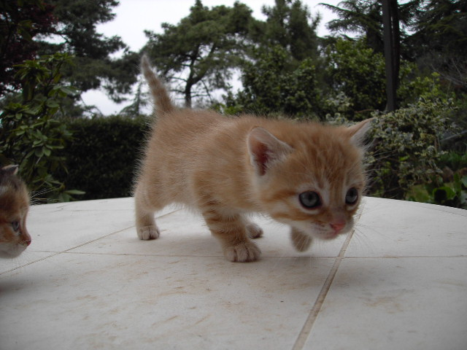
Strategy
Notes:
openSUSE is very young. Looking for it's place in the world. We recently had a discussion about strategy and where we want to go.
Current conclusion:
not limit the user but empower them - as simple as possible but no simpler
New community means: no red tape, very flexible
bottom-up decision model unlike other commercial-supported communities
community is in charge, SUSE interferes barely, no official structures, 'steering groups' or dicators
In process of setting up an openSUSE foundation to govern the project by community
So openSUSE is a real free software project: open for newcomers, you can make a difference.

Slide 8
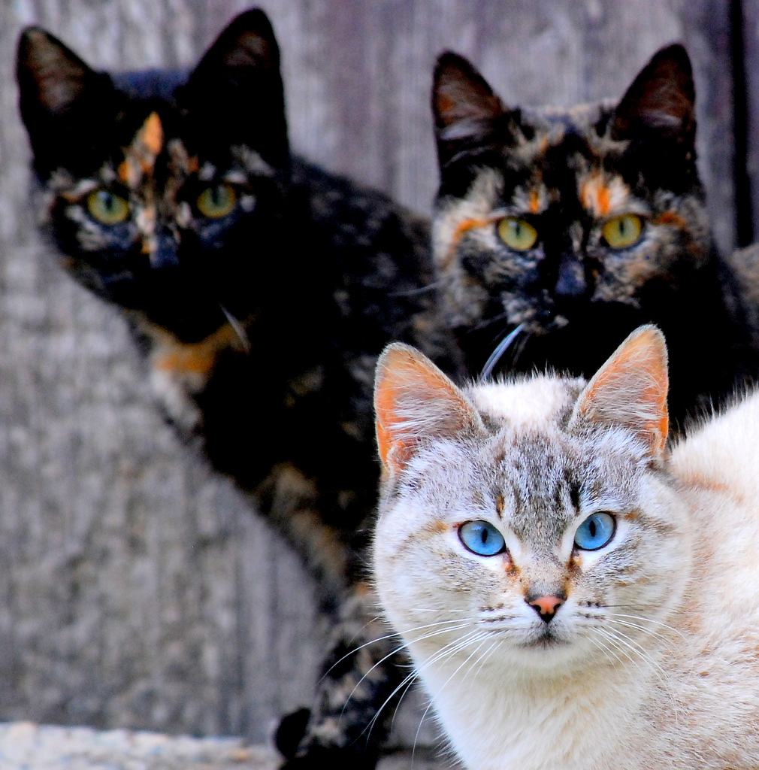
Others
Notes:
One more aspect: as FOSS community openSUSE very open for collaboration
"collaboration across borders" conference
- people from Red Hat, Debian, Mandriva...
- cooperate on dracut (mkinitrd replacement), pulse audio, systemd
- Red Hat and Ubuntu developers using our build service!
- we started “Appstream”, cross-distro collaboration project on application installation
- So we want to push forward all of F/LOSS, not just openSUSE!

Slide 9
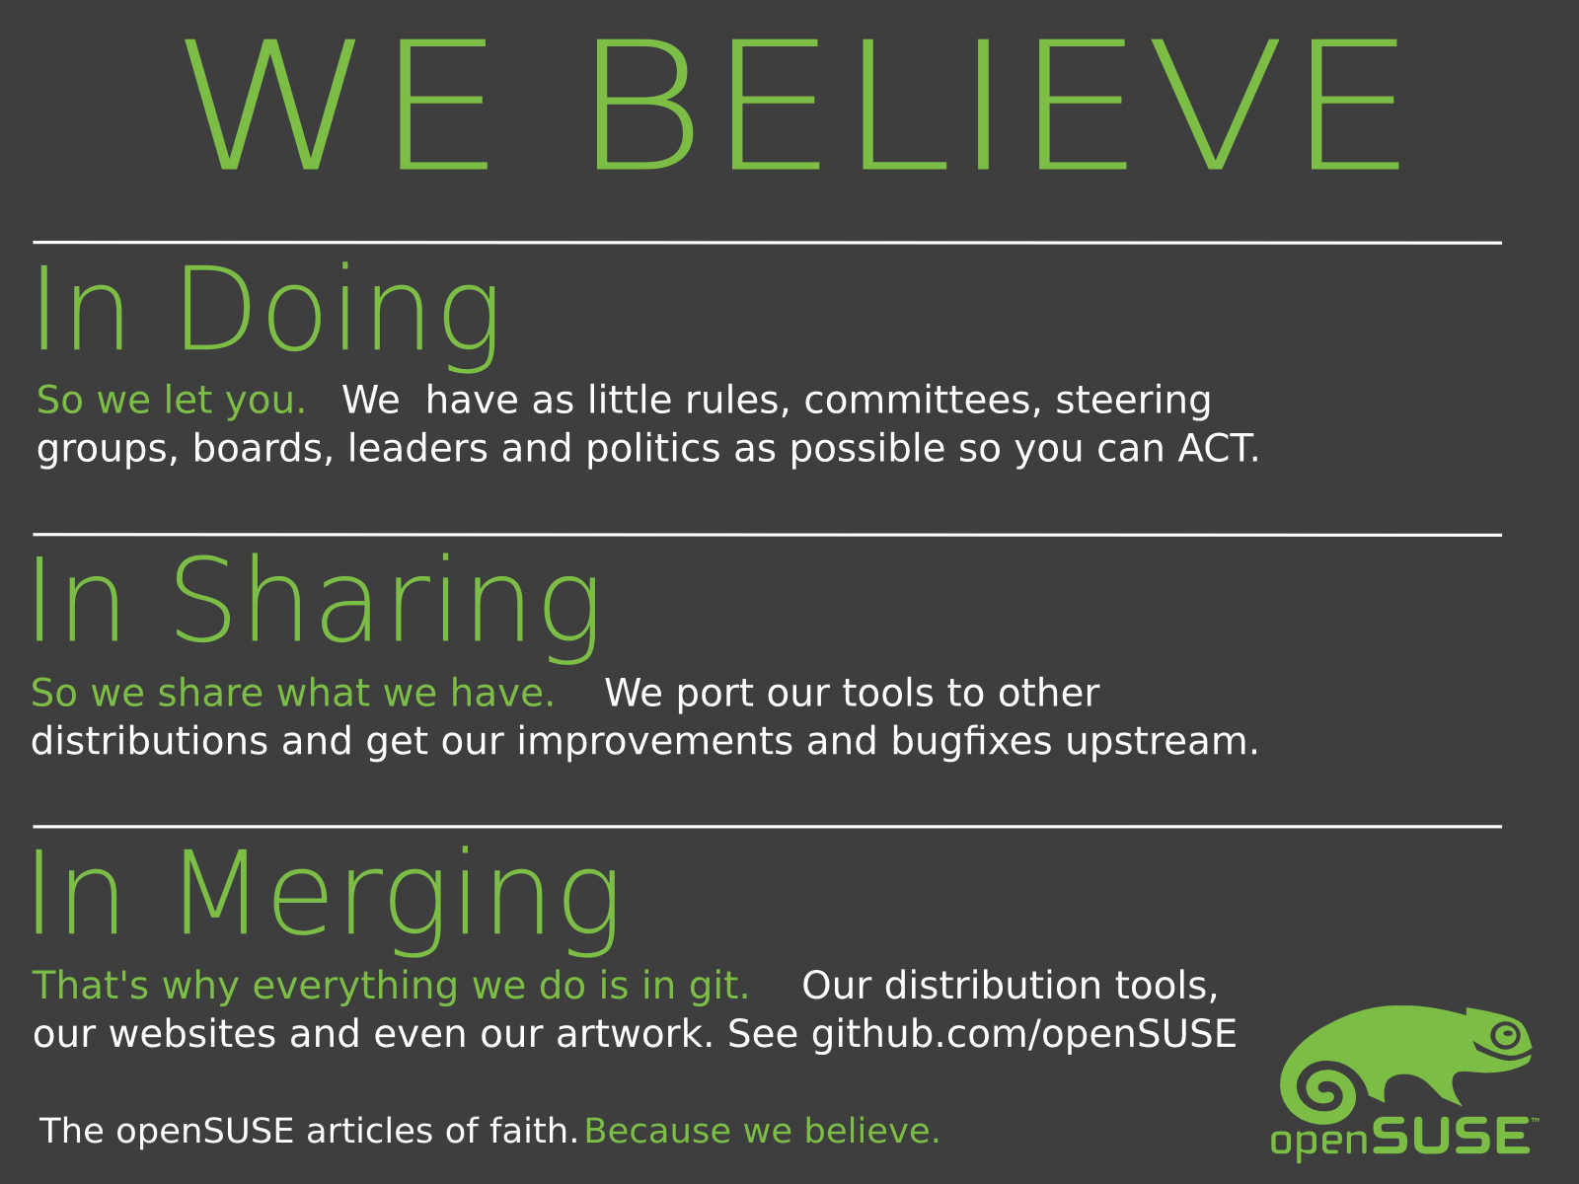
Notes:
All this is summarized in our 'we believe' poster that you might have seen here or there:
We're an international crowd, and we believe that Free and Open is better than Closed. We believe that you get the most out of people by getting out of their way, by letting them share what they do and work with others across project and cultural boundaries!

Slide 10
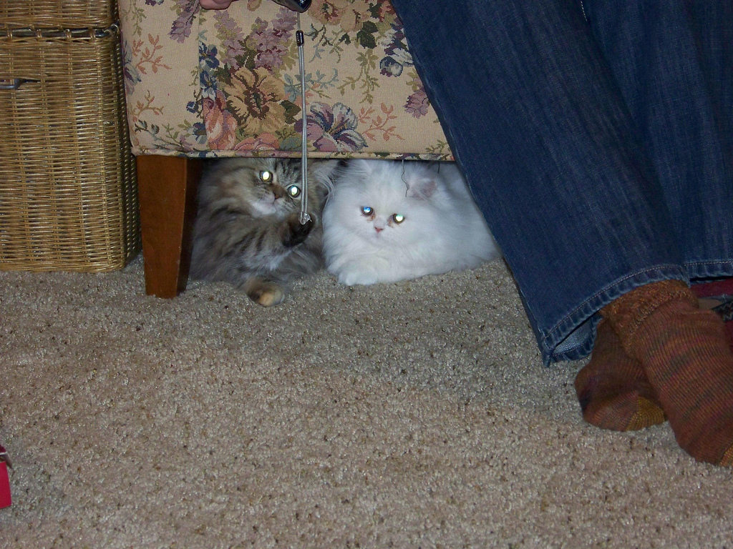
We are nice
Notes:
young
friendly
cooperative
open

Slide 11
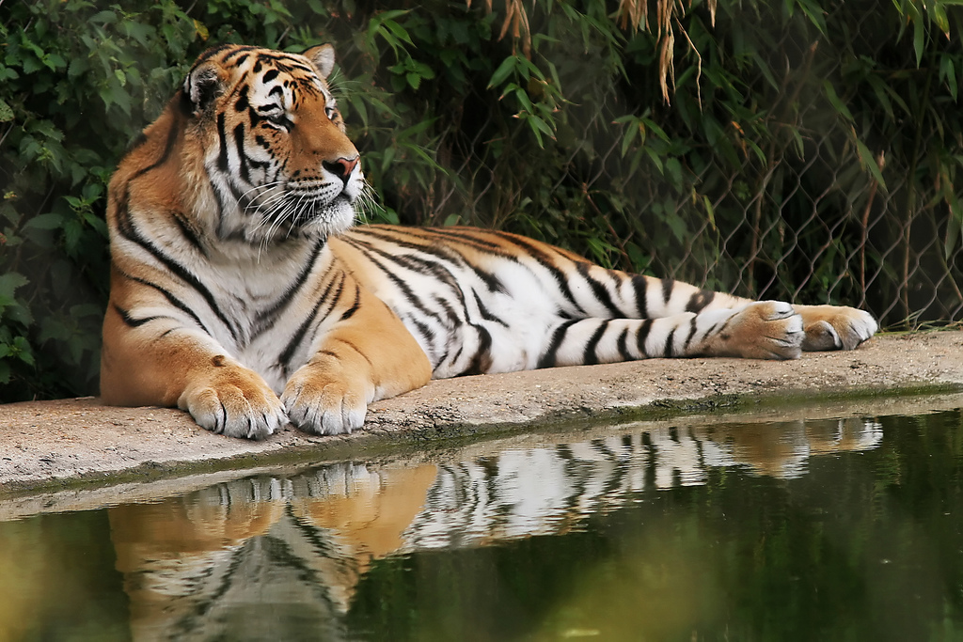
Beware...
Notes:
not complete pussy
Very powerful and unique technology
Like OBS, SUSEStudio, tumbleweed, openQA...

Slide 12

SuperKitty!
Notes:
openSUSE = super Kitty!
Awesome technology
Great plans

Slide 13

Beware of
'ze Cat Lizzard!
Notes:
Yes, the lizzard is cool and awesome ;-)

Slide 14
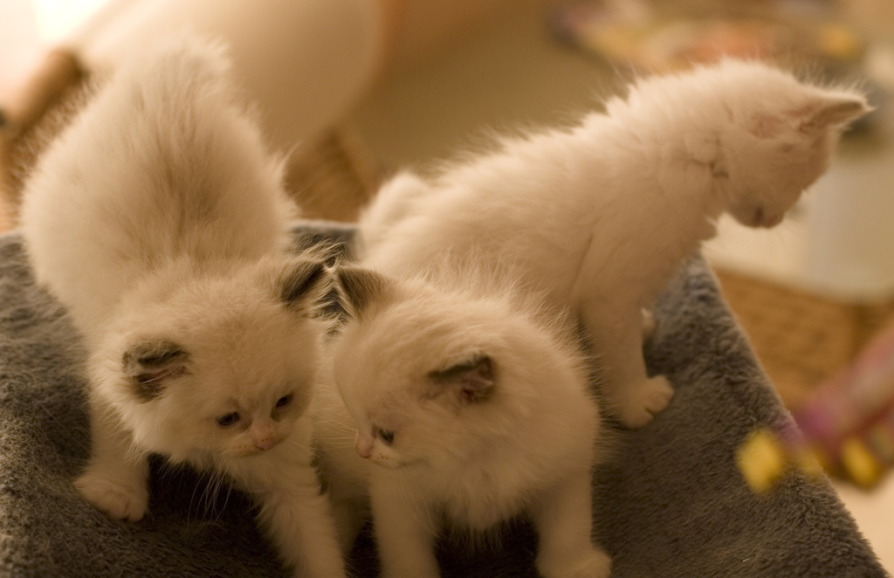
Cuddly kittens!
Notes:
Very FRIENDLY and CUDDLY superkitty!
A real Free Software community. Open, flexible, focussed on Freedom and opportunity, making a difference.

Slide 15

Newcomers welcome
Notes:
Which is always looking for new volunteers
people who actually want to make a difference!

Slide 16
Kitty Image credits
Me: Kostas Koudaras
You: artolog
openSUSE: clevergrrl
SUSE: sensual shadows
Business: marissa cap
Strategy: dabogirl
Others: pasotraspaso
We are nice: cseeman
Beware: ian
SuperKitty: malingering
Cuddly: andreas solberg
Newcomers: abcrumly
Join the gang: malingering
To be found on Flickr under the above names with a Creative Commons license. Thanks all!

Slide 17

opensuse.org
planet.opensuse.org
opensuse.org/Portal:How_to_participate
opensuse.org/Junior_jobs
features.opensuse.org
build.opensuse.org
IRC #opensuse-project

Slide 18

Join the gang
Notes:
... come join us and have fun...
Try openSUSE, Tumbleweed, SUSE Studio, TRY OBS, play with us!

Slide 19
Your next Linux Distribution!

Slide 20
Notes:
To get openSUSE, go to openSUSE.org. You will find download links and more.
To build your own OS on top of openSUSE, go to susestudio.com – you can customize it with your packages, artwork and even files and scripts, then download it for an USB stick, hard drive or CD.
Of course you can look up an openSUSE ambassador like me and see if they have some DVD's of openSUSE for you!

Slide 21
Have a lot of fun!
Notes:
Thanks for listening!

